Slide 1
HELP! I Want to Take the ACT (or SAT). What are the steps?
How to Sign Up for the ACT/SAT
Notes:
Be specific and direct in the title. Use the subtitle to give the specific context of the speech.
-The goal should be to capture the audience’s attention which can be done with a quote, a startling statistic, or fact. It is not necessary to include this attention getter on the slide.

Slide 2
Standardized Tests
Colleges use tests like the ACT and SAT for:
Admission-To compare you to other candidates in their application pool
Placement-To choose the most important courses for you
Scholarship Opportunities
Notes:
Use the background points to post details that are not common knowledge, or that the audience will need to understand the context of the speech.
-Do not read these main points from the PowerPoint, instead elaborate on these points during the speech.

Slide 3
Should I take both the ACT and SAT? What is the difference?
The best way to decide if taking the SAT, ACT, or both tests is right for you is to take a timed full-length practice test of each type. Since the content and style of the SAT and ACT are very similar, factors like how you handle time pressure and what types of questions you find most challenging can help you determine which test is a better fit.
Notes:
The title of main point #1 should be clear and concise. Each piece of evidence should be summarized for clarity and cited correctly. Do not simply read the pieces of evidence, but elaborate where needed.
[type notes for elaboration here]
Be sure to transition to main point #2 and the next slide.

Slide 4
Do You Receive Free or Reduced Lunch?
Students (JUNIORS AND SENIORS ONLY) who receive free or reduced lunch can receive four (4) ACT or SAT waivers in a lifetime. You cannot use the same Fee Waiver. Each waiver has a specific unique code.
Waivers DO EXPIRE! Check the expiration date!
ACT Waivers have 11 digit numbers. These numbers are found on the top right hand side of the page (see illustration)
SAT Waivers have 12 digit numbers. These numbers are listed in the middle of the page (see illustration).
Notes:
The title of main point #2 should be clear and concise. Each piece of evidence should be summarized for clarity and cited correctly. Do not simply read the pieces of evidence, but elaborate where needed.
[type notes for elaboration here]
Be sure to transition to main point #3 and the next slide.

Slide 5
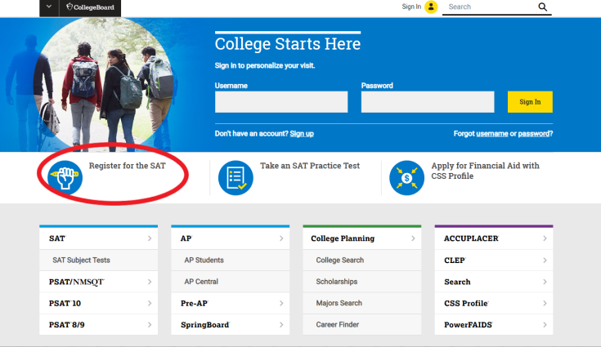
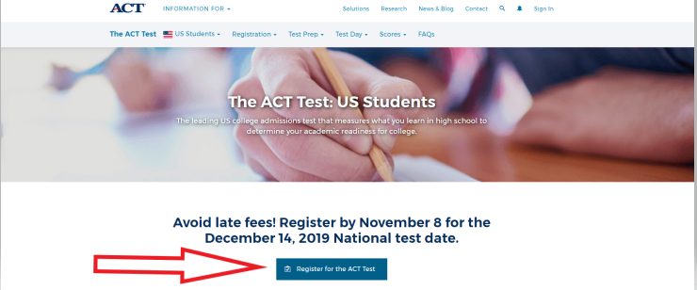
Visit This Website to Register for ACT: www.actstudent.org
Visit This Website to Register for the SAT:
www.collegeboard.com
STEP 1: Register
Notes:
The title of main point #3 should be clear and concise. Each piece of evidence should be summarized for clarity and cited correctly. Do not simply read the pieces of evidence, but elaborate where needed.
[type notes for elaboration here]
Be sure to transition to the counterargument and the next slide.

Slide 6
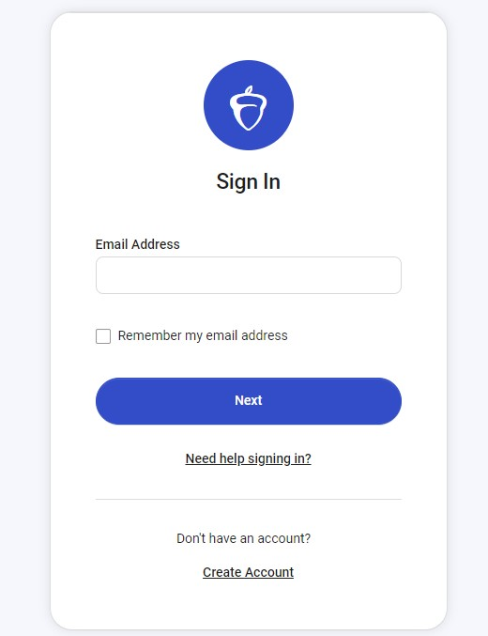
Step 2: Sign In/Create An Account
If you have not registered for an account for the ACT, you need to Create US Account. If you have created and account, log in.
If you have not registered for an Account for the SAT, you will need to create an account. If you have an account, log in.
Remember to write down your ID and Password. It is hard to retrieve it once it is lost. It is your personal login, we do not have that information here at school.
Notes:
The counterargument should be the most common argument against the topic. The goal for this slide is to address the counterargument in such a way as to actually strengthen the original topic. Be sure to address each piece of evidence against the topic. As you address each piece of evidence elaborate on the text found on the slide. Remember to transition to the final slide, the action step.

Slide 7
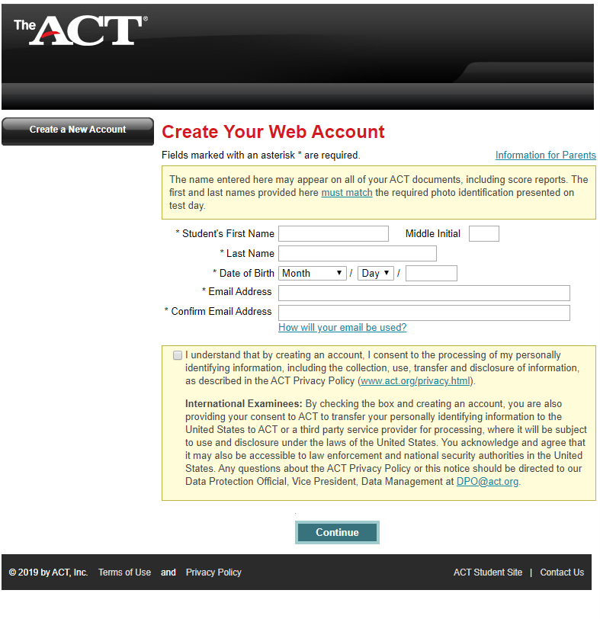
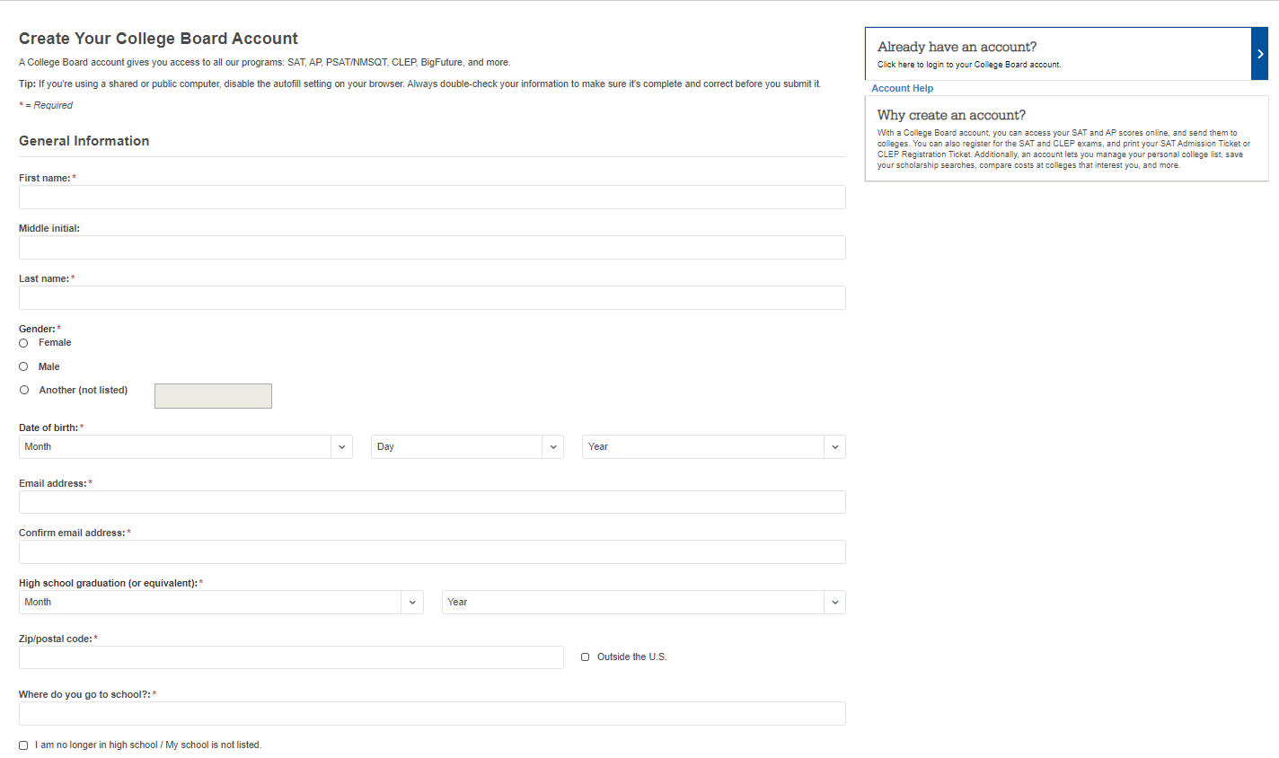
STEP 3: Create your Web
Account
Notes:
The title of main point #3 should be clear and concise. Each piece of evidence should be summarized for clarity and cited correctly. Do not simply read the pieces of evidence, but elaborate where needed.
[type notes for elaboration here]
Be sure to transition to the counterargument and the next slide.

Slide 8
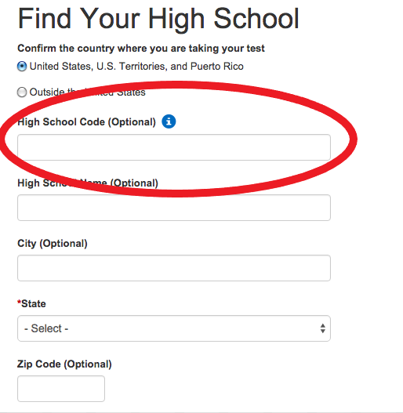
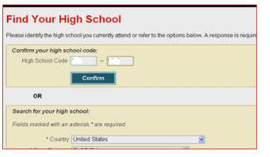
Find Your School
Your ACT School Code is 010-760
Your SAT School Code is 010760
Notes:
The counterargument should be the most common argument against the topic. The goal for this slide is to address the counterargument in such a way as to actually strengthen the original topic. Be sure to address each piece of evidence against the topic. As you address each piece of evidence elaborate on the text found on the slide. Remember to transition to the final slide, the action step.

Slide 9
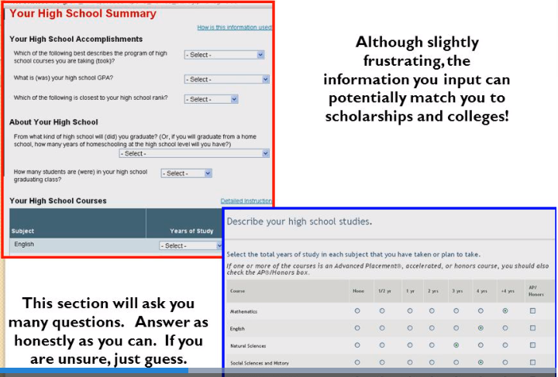
Your High School Summary and Interest Inventory
Notes:
The title of main point #1 should be clear and concise. Each piece of evidence should be summarized for clarity and cited correctly. Do not simply read the pieces of evidence, but elaborate where needed.
[type notes for elaboration here]
Be sure to transition to main point #2 and the next slide.

Slide 10
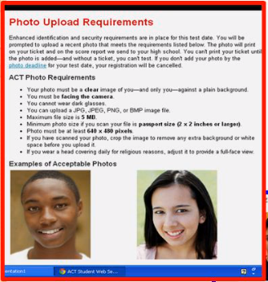
Upload Photo
Notes:
The title of main point #2 should be clear and concise. Each piece of evidence should be summarized for clarity and cited correctly. Do not simply read the pieces of evidence, but elaborate where needed.
[type notes for elaboration here]
Be sure to transition to main point #3 and the next slide.

Slide 11
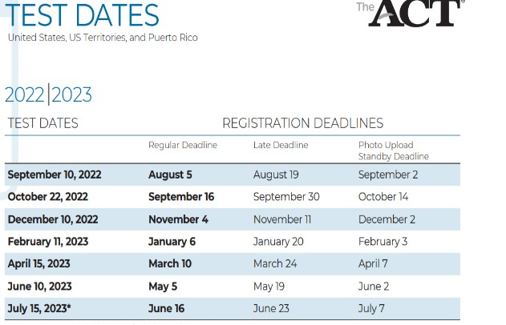
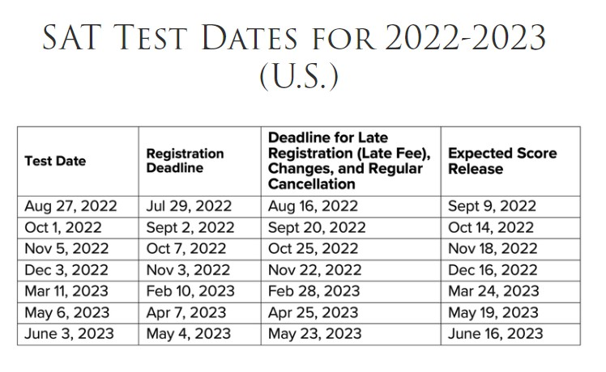
Make sure you pay close attention to registration deadlines to avoid late registration fees. Also, if you received a Fee Waiver, you must use the fee waiver before the regular deadline or it will be invalid.
Select Your Test Date
Select Your Test Location
Cordova High School is not a test site for the ACT or SAT. We only administer the ACT in the Spring each year to our Juniors (for free) as part of our state assessment for Junior students. You will need to select a location that you would want to drive to (most likely a location that is closest to your house).
Notes:
The title of main point #3 should be clear and concise. Each piece of evidence should be summarized for clarity and cited correctly. Do not simply read the pieces of evidence, but elaborate where needed.
[type notes for elaboration here]
Be sure to transition to the counterargument and the next slide.

Slide 12
Score Reports
You can add up to four schools to send your scores for FREE! If you do not add the schools during registration, score reports will cost you extra money to send per school ($16 per report!). Don’t be afraid to send your scores. Athletes---Don’t forget to send a copy to the NCAA! Code 9999
Notes:
The counterargument should be the most common argument against the topic. The goal for this slide is to address the counterargument in such a way as to actually strengthen the original topic. Be sure to address each piece of evidence against the topic. As you address each piece of evidence elaborate on the text found on the slide. Remember to transition to the final slide, the action step.

Slide 13
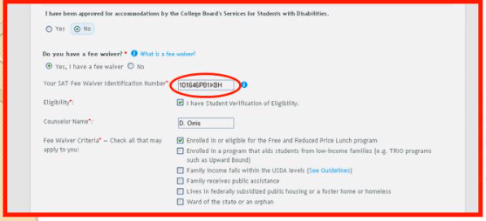
Payment With a Waiver
Don’t waste your waiver by losing it or not showing up on test date!
Never input credit card information when paying with a waiver.
Enter Waiver Number
Waiver numbers can only be used once
Waivers do expire!
Notes:
The title of main point #2 should be clear and concise. Each piece of evidence should be summarized for clarity and cited correctly. Do not simply read the pieces of evidence, but elaborate where needed.
[type notes for elaboration here]
Be sure to transition to main point #3 and the next slide.

Slide 14
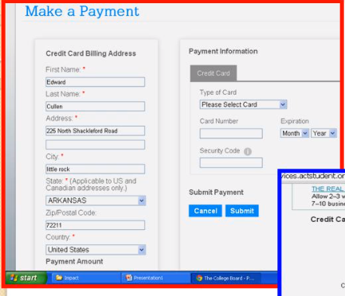
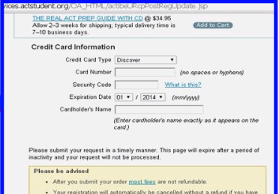
Payment with a Credit Card
If a parent does not have a credit card, you can purchase a Visa, MasterCard, or Amex Gift Card and use it to make your payment.
Notes:
The counterargument should be the most common argument against the topic. The goal for this slide is to address the counterargument in such a way as to actually strengthen the original topic. Be sure to address each piece of evidence against the topic. As you address each piece of evidence elaborate on the text found on the slide. Remember to transition to the final slide, the action step.

Slide 15
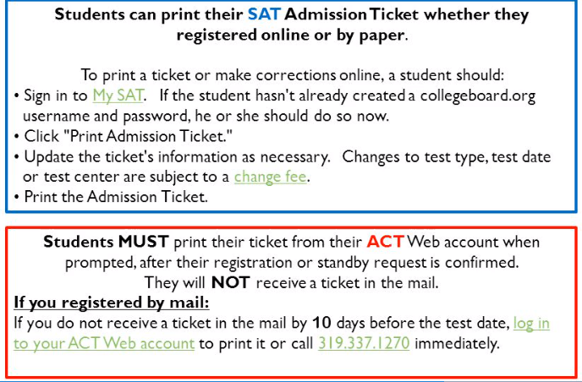
Print Your Admissions Ticket
Notes:
The title of main point #3 should be clear and concise. Each piece of evidence should be summarized for clarity and cited correctly. Do not simply read the pieces of evidence, but elaborate where needed.
[type notes for elaboration here]
Be sure to transition to the counterargument and the next slide.

Slide 16
Should I Purchase Their Review Guides?
If YOU really want to…..
Please know there are other resources on the web that are FREE (Google ACT prep, SAT prep)
Notes:
The title of main point #1 should be clear and concise. Each piece of evidence should be summarized for clarity and cited correctly. Do not simply read the pieces of evidence, but elaborate where needed.
[type notes for elaboration here]
Be sure to transition to main point #2 and the next slide.

Slide 17
Wrap Up: Important Things to Remember!
You must print out your ticket. Bring one (1) ticket and a valid
photo ID with you on test day.
⬧ You will not be admitted without the test ticket and valid ID!
Go prepared! Make sure to bring several #2 pencils,
approved calculator, ticket, picture ID, and snacks.
⬧ Get a good nights sleep AND have a good breakfast.
⬧ Be on time. You WILL NOT be admitted if you are late.

